Slide 1

Using Structured Query Language (SQL)
Jeffery S. Horsburgh
Hydroinformatics
Fall 2016
This work was funded by National Science Foundation Grants EPS 1135482 and EPS 1208732

Slide 2
Quick Review
What we have learned so far
Describing data with effective metadata
Data model design – organizing your data/metadata
Database implementation – creating a database and loading data
Today: What you can do once you get your data in a database!!

Slide 3
Objectives
Retrieve and use data from data models used in Hydrology such as the Observations Data Model (ODM)
Introduce the syntax of Structured Query Language (SQL) for common query types
Construct SQL queries to retrieve data

Slide 4
What is Structured Query Language?
Special purpose programming language for managing data in relational database management systems (RDBMS)
Adopted by the American National Standards Institute (ANSI) and the International Standards Organization (ISO) as the standard data access language
Set of standard commands + proprietary extensions
“SELECT”
“INSERT”
“UPDATE”
“DELETE”
…
Mostly human readable

Slide 5
Structured Query Language (SQL)
Data Definition Language (DDL)
Definition of database structure (relational schemas)
Data access control
Data Manipulation Language (DML)
Query language to create, read, update, and delete database objects

Slide 6
Ways to Execute SQL Commands
Through a database client application like MySQL Workbench
Via code (e.g., Visual Basic, C#, Java, R, Python, etc.) that sends a query to a database and returns results

Slide 7
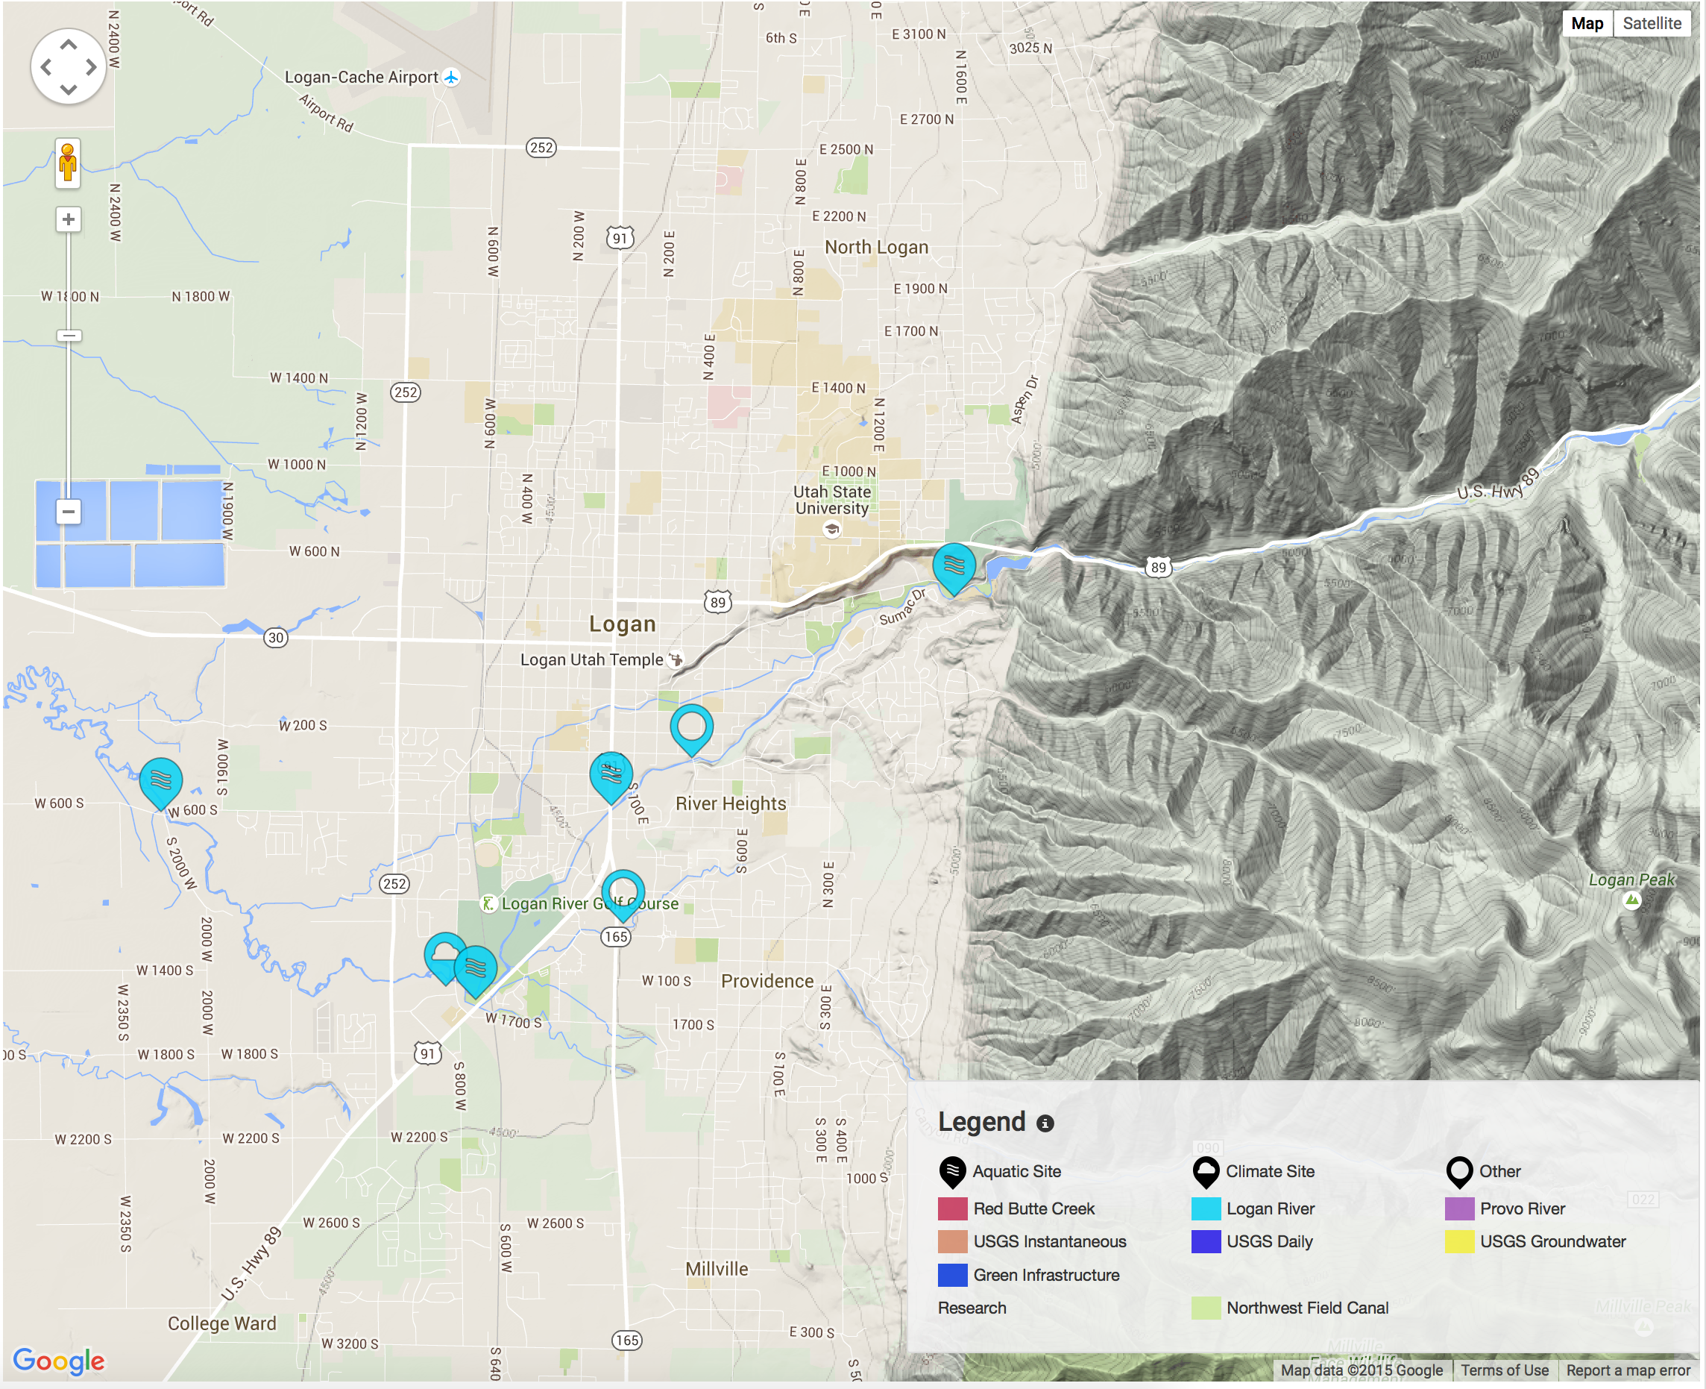
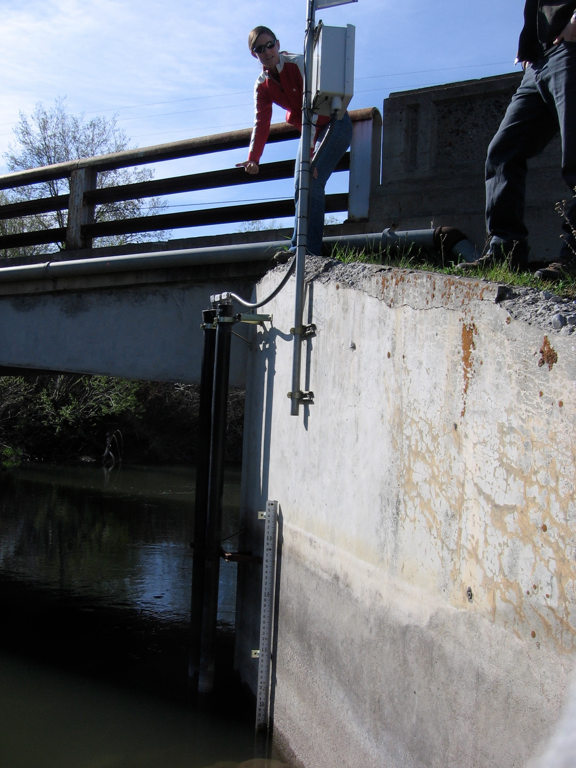
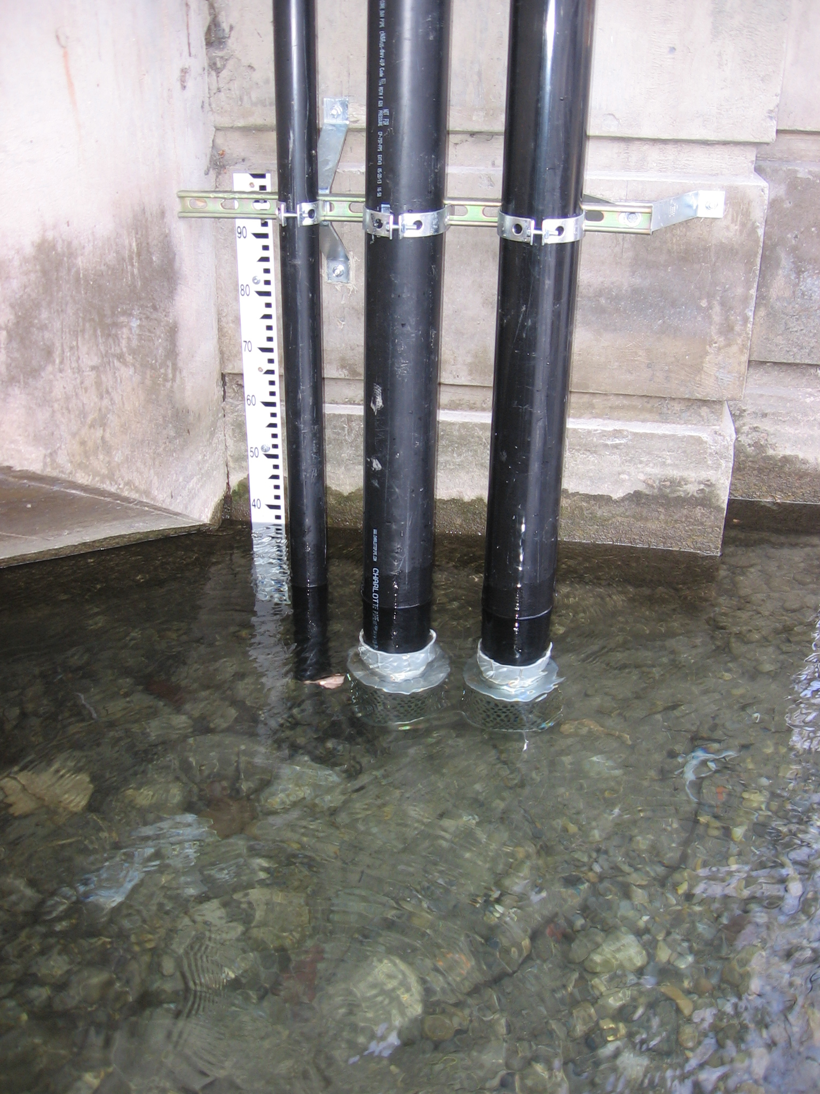
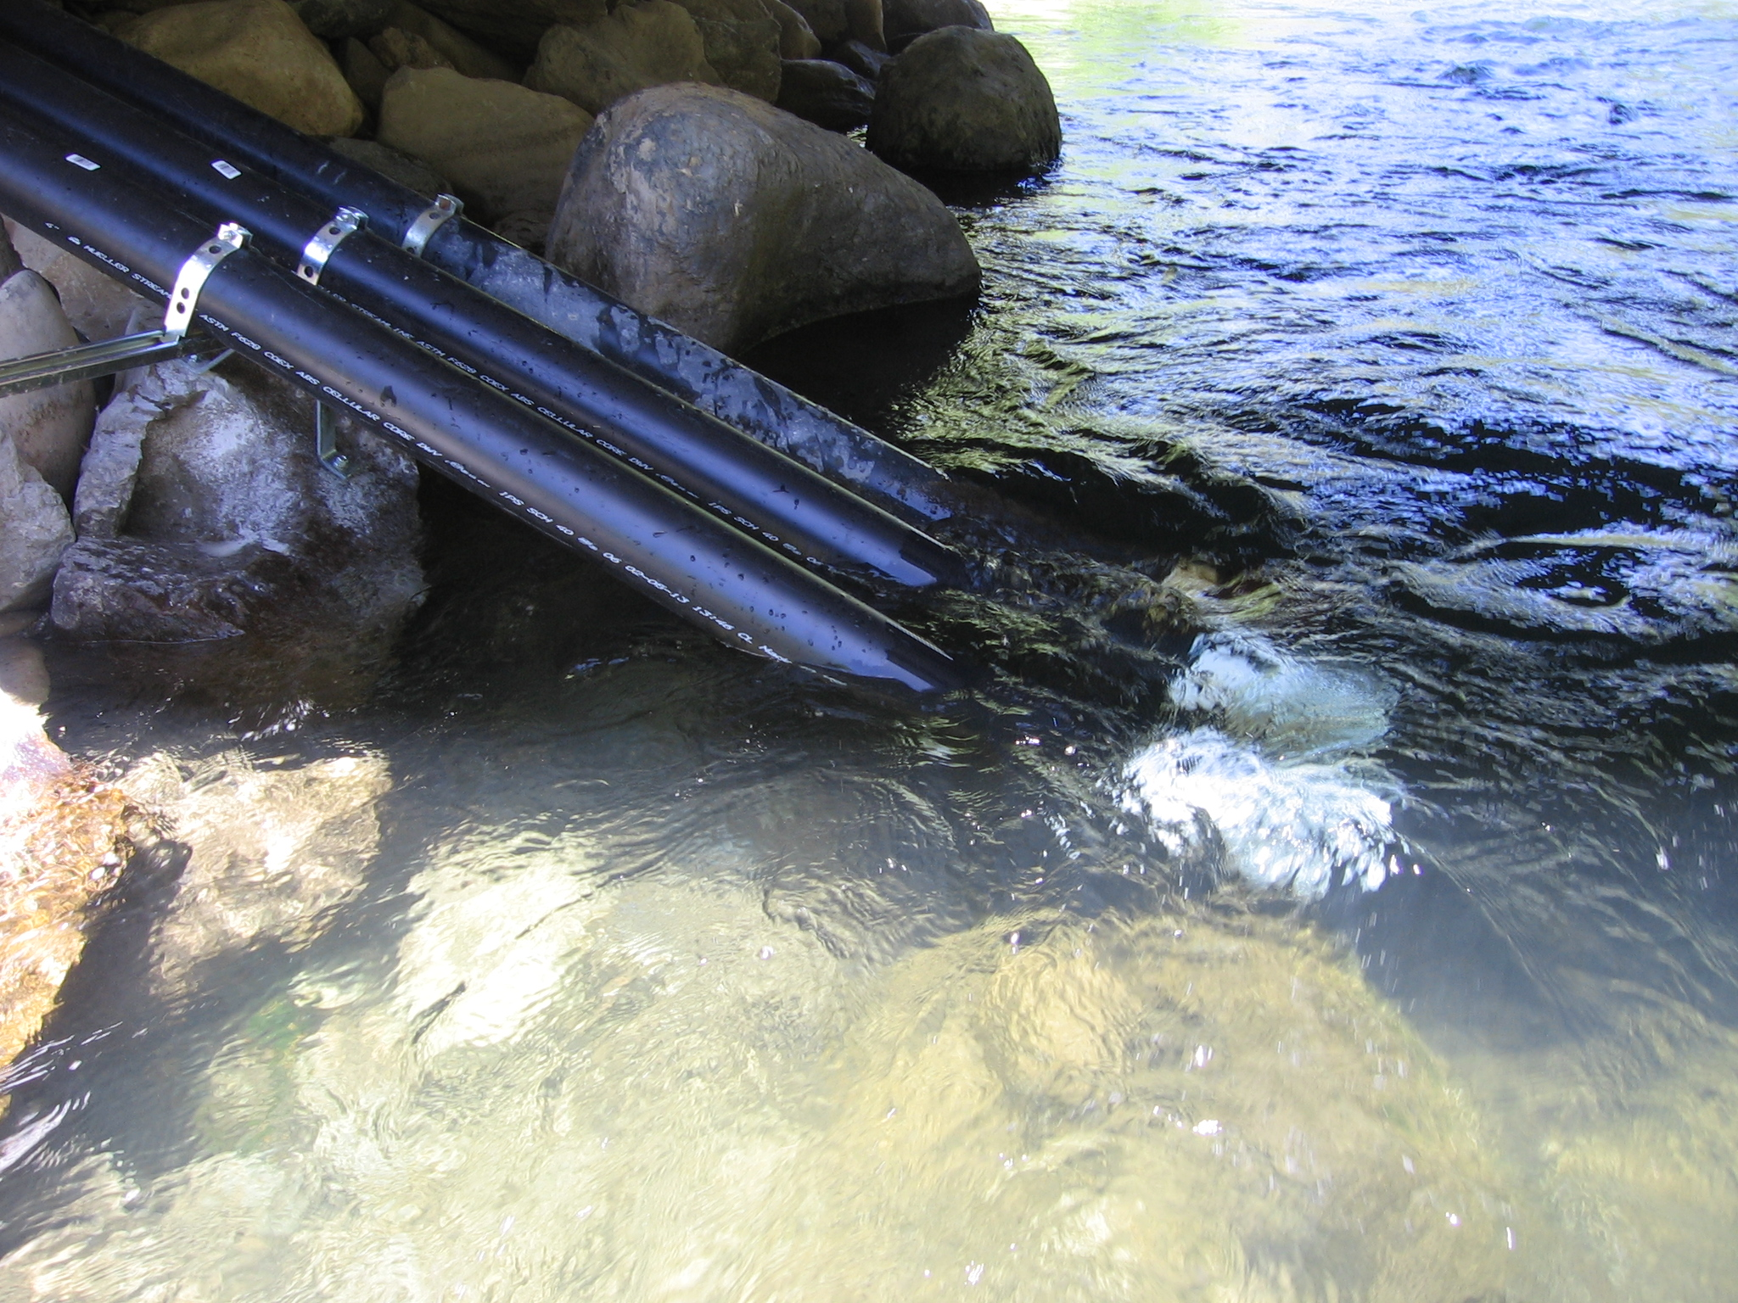
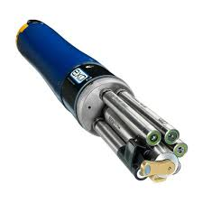
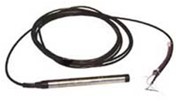

The Data We Will Be Using
The Logan River GAMUT Data

Slide 8
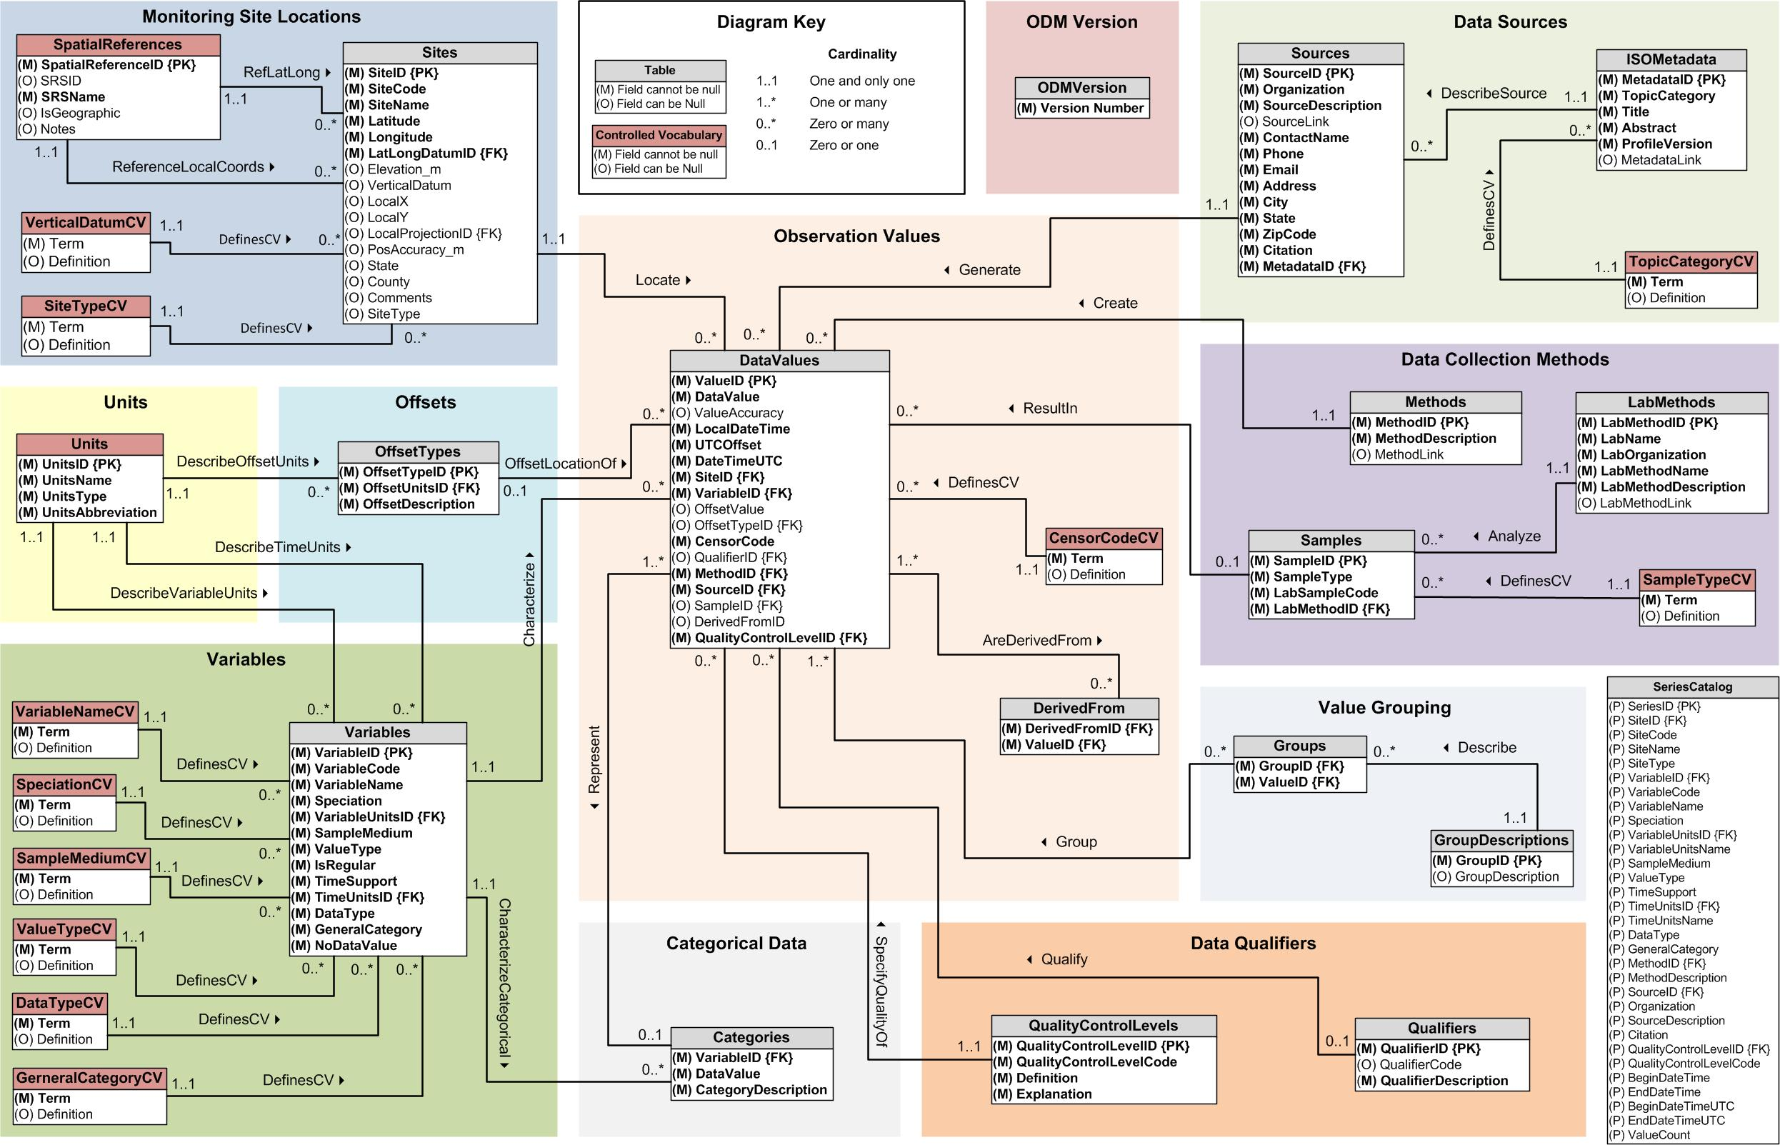
Observations Data Model

Slide 9
Basic SQL Query Structure
A basic SQL query consists of a SELECT, a FROM, and a WHERE clause
SELECT
Specifies the columns to appear in the result
FROM
Specifies the tables to use
WHERE
Filters the results based on criteria
The order of the clauses cannot be changed

Slide 10
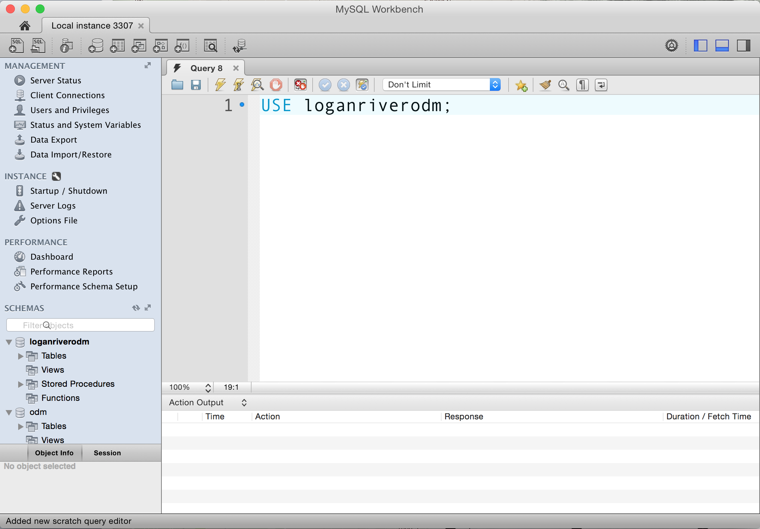
Create a New Query in MySQL Workbench
USE loganriverodm;
Tells MySQL which database to use
Create a new SQL tab for executing queries

Slide 11
Selecting Data
“SELECT” is used to query the database and retrieve data that match specified criteria
SELECT is the core of SQL and covers the vast majority of queries
SELECT statement syntax:
SELECT Field_1, Field_2, Field_n
FROM TableName;

Slide 12
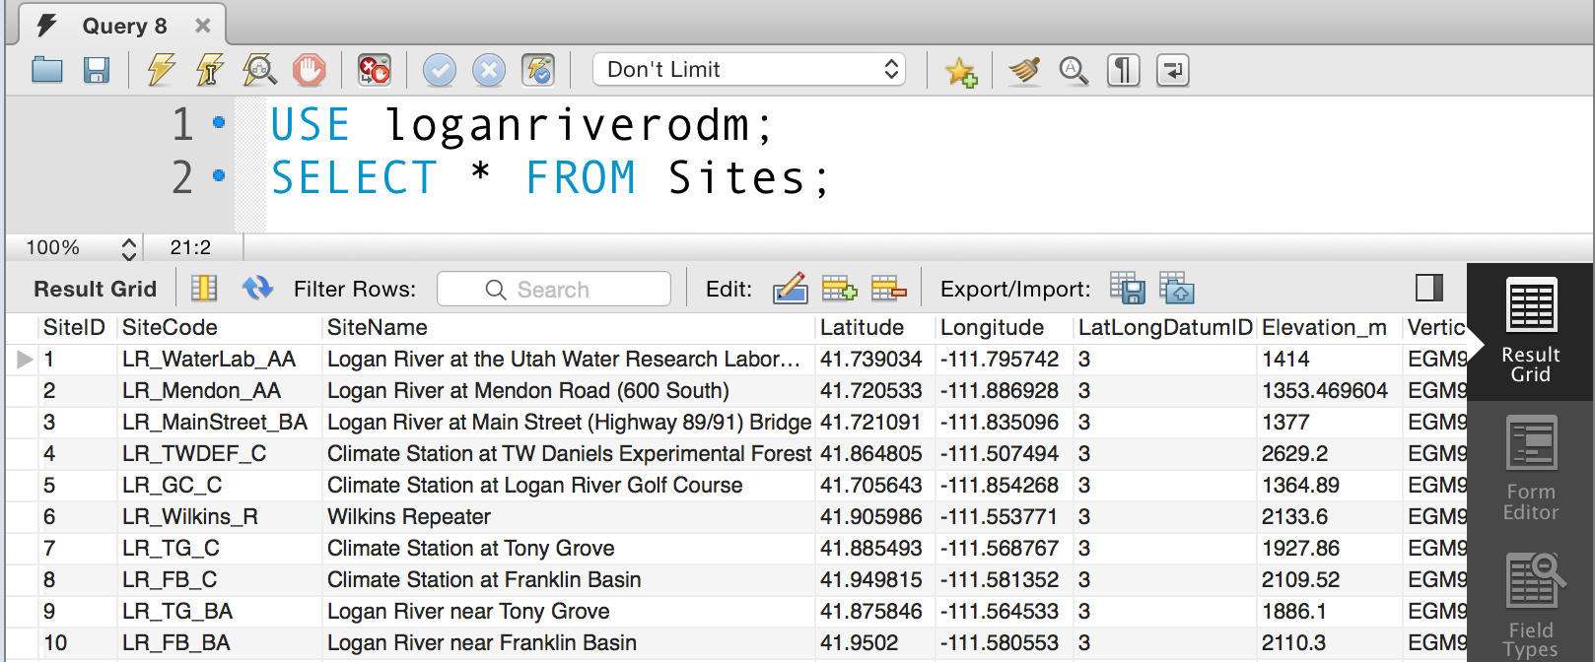
Example Select Queries
Select all fields from a table:
SELECT * FROM Sites;
The “*” means – give me all of the fields/columns in the table

Slide 13
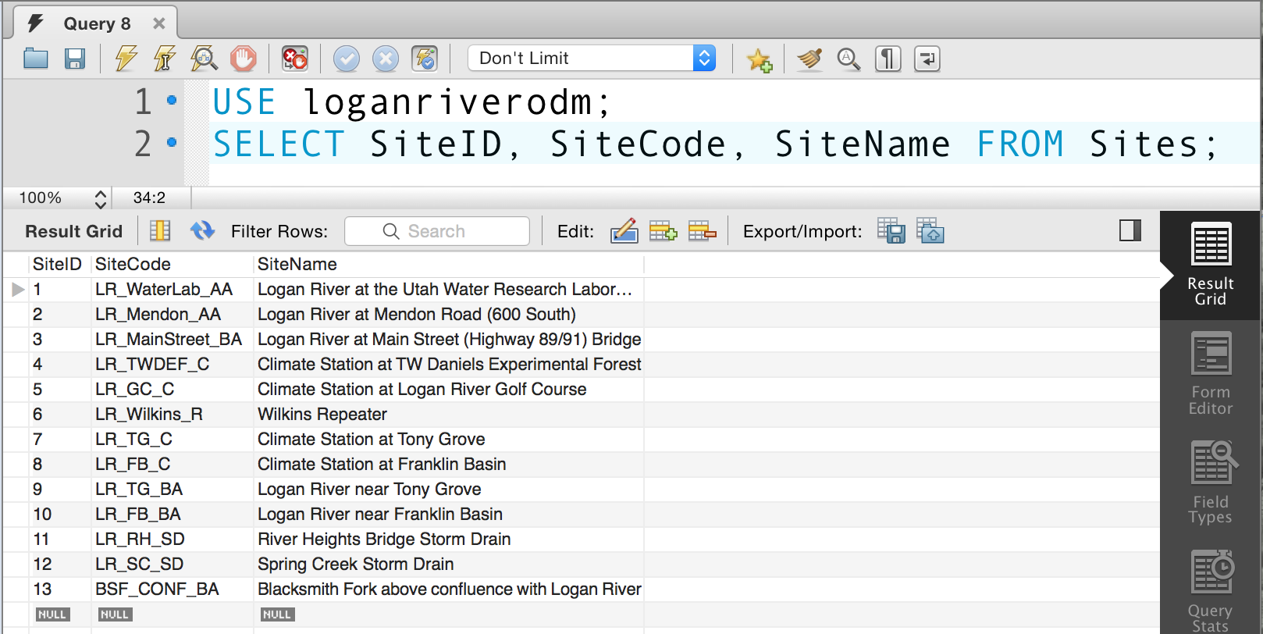
Example Select Queries
Retrieve only selected fields from a table:
SELECT SiteID, SiteCode, SiteName FROM Sites;

Slide 14
Adding Criteria to SELECT Queries
The “WHERE” clause specifies which data values or records will be returned based on criteria
Conditional operators used with the WHERE clause:
= Equal
> Greater than
< Less than
<= Less than or equal
>= Greater than or equal
<> Not equal to
LIKE Match a substring, with “%” as a wildcard character
IN/NOT IN Supply a list of items to test
BETWEEN Test between two given values
…

Slide 15
Adding Criteria to SELECT Queries
Syntax for adding criteria to a SELECT query:
SELECT Field_1, Field_2, Field_n FROM TableName
WHERE Field_1 = SomeCondition AND/OR Field_2 = AnotherCondition;

Slide 16
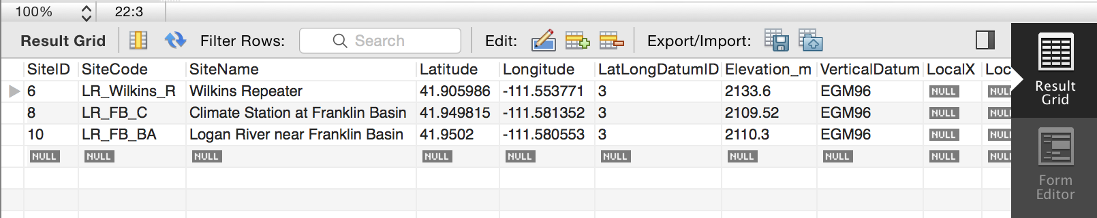
Adding Criteria to SELECT Queries
Example: “Which sites in the Logan River are north of 41.9 degrees latitude?”
SELECT * FROM Sites WHERE Latitude > 41.9;
Latitude > 41.9

Slide 17
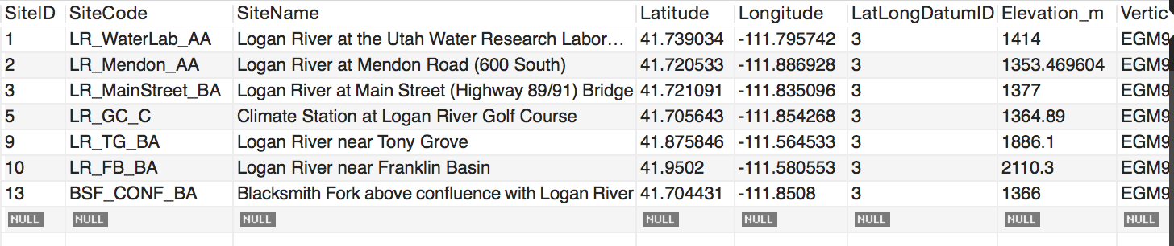
Adding Criteria to SELECT Queries
Example: “Select sites whose name contains ‘Logan River’”
SELECT * FROM Sites
WHERE SiteName LIKE '%Logan River%';

Slide 18
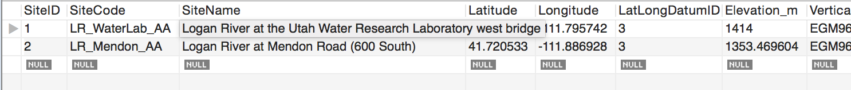
Adding Criteria to SELECT Queries
Example: Select Sites with SiteID 1 and 2
SELECT * FROM Sites WHERE SiteID < 3;
SELECT * FROM Sites WHERE SiteID IN (1,2);

Slide 19
Multiple Criteria and Boolean Operators
AND – both sides must be true
OR – either side can be true
SELECT * FROM Sites WHERE SiteID = 1 AND SiteID = 2;
Returns no results (0 records)
SELECT * FROM Sites WHERE SiteID = 1 OR SiteID = 2;
Returns 2 records

Slide 20
Sorting Results Using ORDER BY
The ORDER BY clause can be used to arrange query results in ascending (ASC) or descending (DESC) order
Example: “Give me quality controlled (QualityControlLevelID = 1) water temperature observations (VariableID = 57) for SiteIDs 1 and 2, order the results by SiteID and then by LocalDateTime in ascending order.”
SELECT * FROM DataValues
WHERE SiteID IN (1,2) AND VariableID = 57
AND QualityControlLevelID = 1
ORDER BY SiteID ASC, LocalDateTime ASC;

Slide 21
Selecting DISTINCT Values
Select a list containing distinct values
Example: “Give me a non-repetitive list of Variable Names used in the Variables table.”
This gives me repetitive values:
SELECT VariableName FROM Variables;
Do this instead:
SELECT DISTINCT VariableName FROM Variables;

Slide 22
NULL Values
Missing (unknown) info is represented by NULL values
Result of any comparison involving a NULL value is Unknown
SELECT * FROM Sites WHERE LocalX IS NULL;
SELECT * FROM Sites WHERE LocalX IS NOT NULL;
What if I do:
SELECT * FROM Sites WHERE LocalX < 430726;

Slide 23
Selecting from More than One Table
The “JOIN” statement makes queries relational
Joins allow you to select information from more than one table using one SELECT statement
JOIN syntax:
SELECT LeftTable.Field1, LeftTable.Field1, RightTable.Field1, RightTable.Field2
FROM LeftTable
Join_Type RightTable
ON JoinCondition;

Slide 24
Join Example
DataValues(RightTable)
Sites (LeftTable)
ValueID | SiteID | VariableID | DataValue
1 | 1 | 3 | 8
2 | 1 | 3 | 9
3 | 2 | 3 | 7
4 | 2 | 3 | 8
SiteID | SiteName
1 | Little Bear River
2 | Logan River
SELECT Sites.SiteID, Sites.SiteName, DataValues.VariableID, DataValues.DataValue
FROM Sites
INNER JOIN DataValues
ON Sites.SiteID = DataValues.SiteID;
SiteID | SiteName | VariableID | DataValue
1 | Little Bear River | 3 | 8
1 | Little Bear River | 3 | 9
2 | Logan River | 3 | 7
2 | Logan River | 3 | 8
Result

Slide 25
Types of Joins
INNER JOIN: Takes every record in the LeftTable and looks for 1 or more matches in the RightTable based on the JoinCondition. All matched records are added to the result.
OUTER JOIN: Brings two tables together but includes data even if the JoinCondition does not find matching records
3 Variations: LEFT OUTER JOIN, RIGHT OUTER JOIN, FULL OUTER JOIN

Slide 26
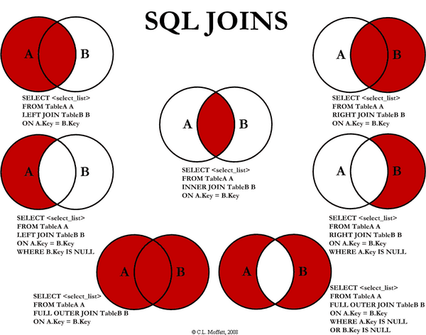
Source: http://www.codeproject.com/Articles/33052/Visual-Representation-of-SQL-Joins

Slide 27
Example Using Joins
“What are the names of the variables that have been measured in the Logan River at Mendon Road?”

Slide 28
Example Using Joins
Join on SiteID
Join on VariableID

Slide 29
Example Using Joins
“What are the names of the variables that have been measured in the Logan River at Mendon Road?”
SELECT DISTINCT Sites.SiteCode, Sites.SiteName,
Variables.VariableName
FROM Sites
INNER JOIN DataValues
ON Sites.SiteID = DataValues.SiteID
INNER JOIN Variables
ON DataValues.VariableID = Variables.VariableID
WHERE Sites.SiteCode = 'LR_Mendon_AA'
ORDER BY VariableName ASC;
“DISTINCT” ensures that I only get unique combinations
Select what we want in the output.
FROM the left table
INNER JOIN to the right table on the common field
Specify criteria and sort output

Slide 30
Quick Summary: Formulating a SQL Statement
1. Identify the field(s) containing the source data | SELECT Field_1, Field_2, Field_n
2. Identify the table(s) where the fields are located | FROM Table_1
3. Specify criteria to narrow the results | WHERE Field_1 = SomeCriteria
4. Determine the order to present records in the results | ORDER BY Field_1 ASC

Slide 31
Challenge Query 1
Select the quality controlled (QualityControlLevelID = 1) median turbidity (VariableID = 66) data values for the Logan River at Mendon Road (SiteID = 2).
http://goo.gl/fspffe

Slide 32
Challenge Query 2
What is the SiteCode and SiteName for each of the sites at which water temperature (VariableID = 57) has been measured?
http://goo.gl/fspffe

Slide 33
Summary
SQL provides a very powerful standard language for querying table-based data
SQL enables you to quickly isolate subsets of data
SQL is mostly standardized, with some vendor-specific extensions
Most database functions can be automated using SQL

Slide 34
Resources for Learning SQL
Microsoft Developer Network (MSDN) SQL Reference
http://msdn.microsoft.com/en-us/library/bb510741%28v=sql.105%29.aspx
Google
Various books – but may want to start with one that is specific to the RDBMS you plan to use (e.g., MySQL)
Another nice discussion on joins: http://www.tek-tips.com/faqs.cfm?fid=4785

